Slide 1
Adaptive cooperative detection method for unmanned planetary vehicles based on deep reinforcement learning

Slide 2
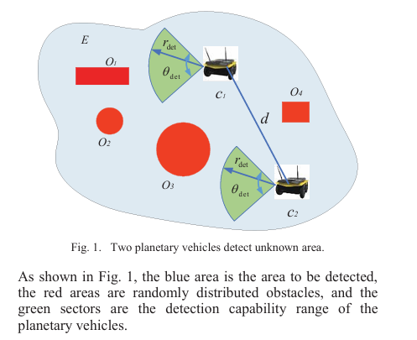

Slide 3
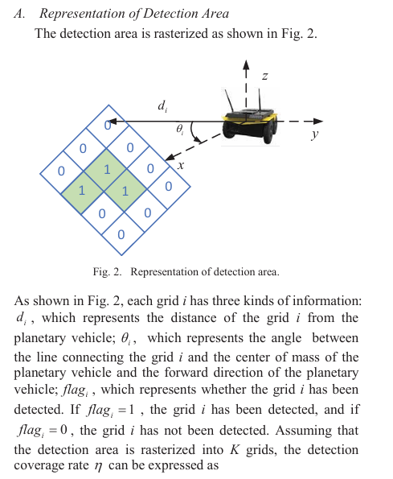


Slide 4
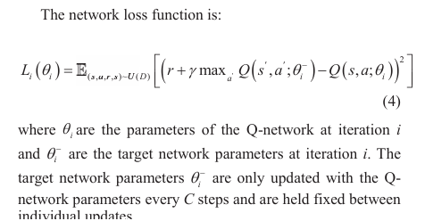

Slide 5
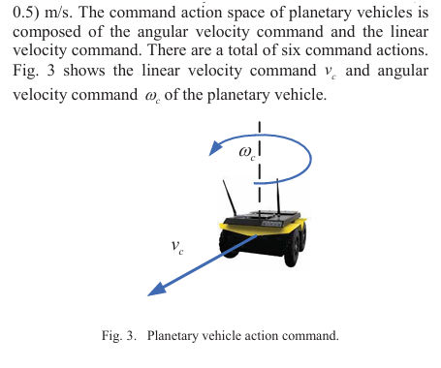

Slide 6
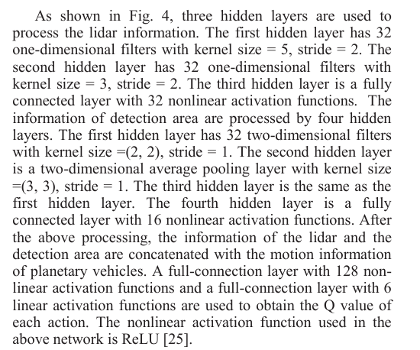
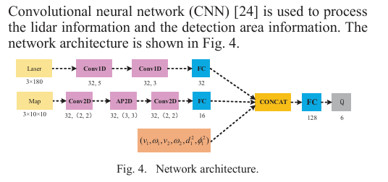

Slide 7
1. The Top Branch: Processing Lidar Data
Lidar data is fundamentally sequential; it is an array of distance measurements swept across a horizontal plane.
Laser (3x180): This represents the raw input. The researchers chose to feed the network 3 consecutive temporal scans, with each scan consisting of 180 distance measurements (sweeping from -90 to 90).This allows the network to perceive not just where obstacles are, but how fast they are moving relative to the vehicle.
Conv1D (32, 5) and Conv1D (32, 3): These are 1-Dimensional Convolutional Layers. 1D convolutions are highly efficient at extracting local patterns from sequential signals. They slide a mathematical window (size 5, then size 3) across the sequence of distances to detect local relationships, such as sharp drops or peaks that represent the physical edges of obstacles. The "32" means the network uses 32 different filters to learn 32 distinct geometric obstacle patterns.
FC (32): A Fully Connected (dense) layer. It flattens the extracted geometric features into an abstract, 32-parameter vector.
2. The Bottom Branch: Processing Spatial Maps
The environment map is fundamentally spatial; it is a 2D grid.
Map (3x10x10): This represents three distinct 10x10 spatial matrices (Distance, Angle, and Detection Flags) that encode the rasterized grid of the target area.
Conv2D (32, (2, 2)): A 2-Dimensional Convolutional Layer. Instead of a 1D line, this slides a 2x2 grid over the map matrices. 2D convolutions are the standard for extracting spatial features, allowing the network to understand the topological relationship between mapped and unmapped zones.
AP2D (32, (3, 3)): An Average Pooling 2D layer. This slides a 3x3 window over the data and calculates the average value. This is a critical design choice because it provides "translation invariance"—it forces the network to learn the general spatial relationships of the environment rather than memorizing exact, rigid grid coordinates.
FC (16): A Fully Connected layer that flattens the 2D spatial features into a dense 16-parameter vector.

Slide 8
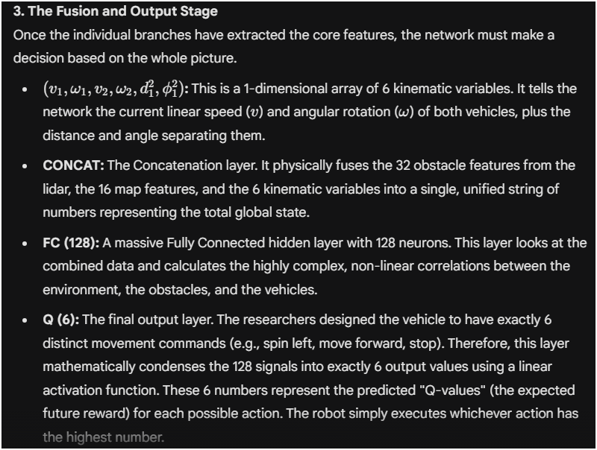

Slide 9
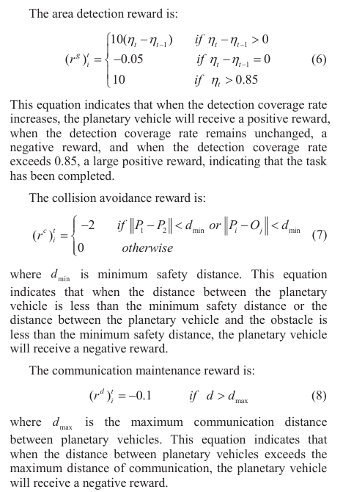

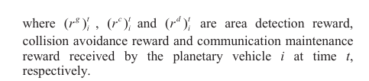

Slide 10
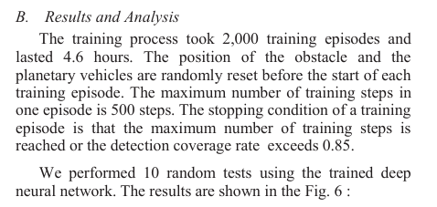
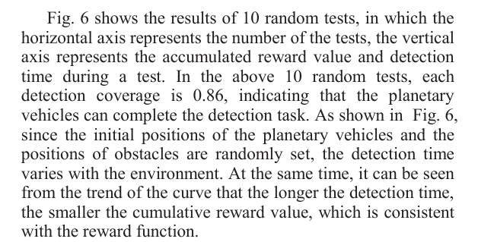
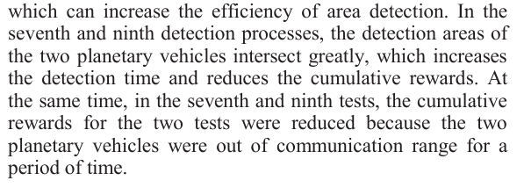

Slide 11
